Slide 1
Who should be prioritized for pharmacological weight management?
Matteo Monami
Diabetology and Metabolic Disease Unit
Careggi Teaching Hospital

Slide 2

Dr. M. Monami has received speaking fees/grants from:
Boehringer
Lilly
Novonordisk
Biocomposites
Molteni
and from the following scientific societies:
SICOB
IFSO
EASO
SIO

Slide 3
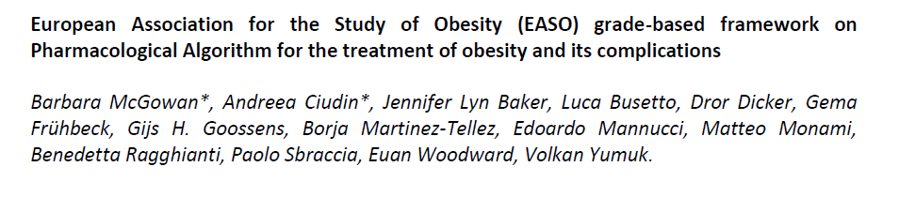
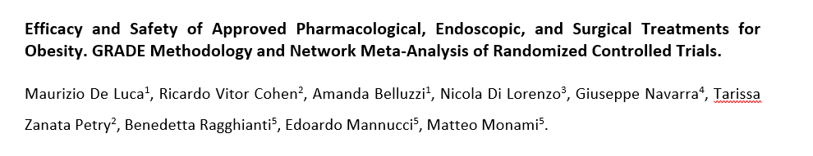
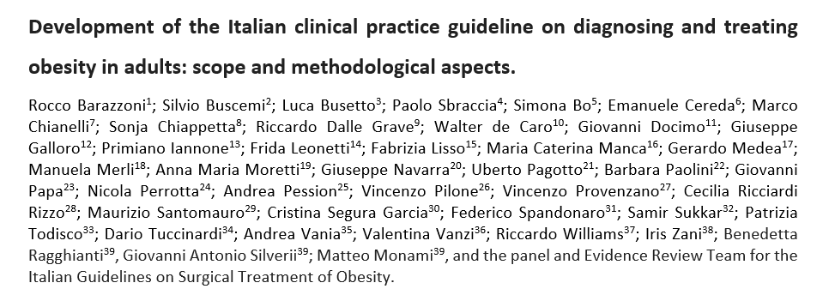

Slide 4
McGowan et al., manuscript submitted
Notes:
EASO is mainly focused on the pharmacological treatment of overweight/obesity almoust forgetting the surgical option. As a consequence, they wanted me to collect RCTs considering pharmacological strategieds only

Slide 5
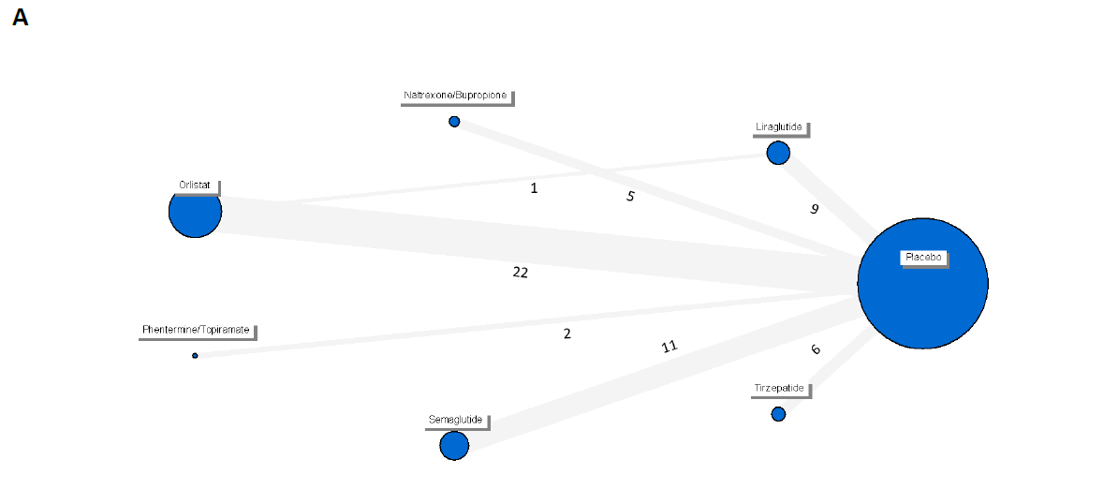
B
2 years
N= 22 trials
C
1 year
N= 58 trials
Search string: (obesity or overweight) AND (orlistat OR naltrexone OR bupropion OR liraglutide OR semaglutide OR tirzepatide OR phentermine/topiramate) up to 31st Jan, 2025. Treatment duration > 52±4 weeks.

Slide 6
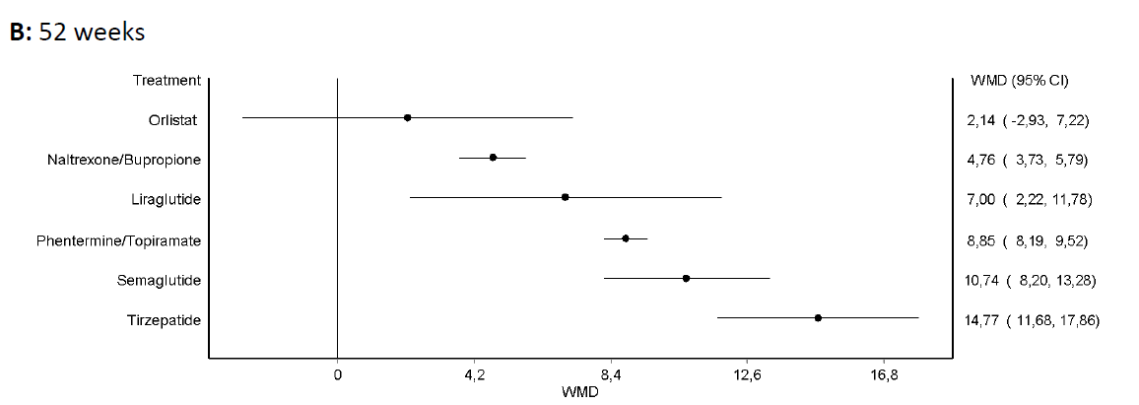
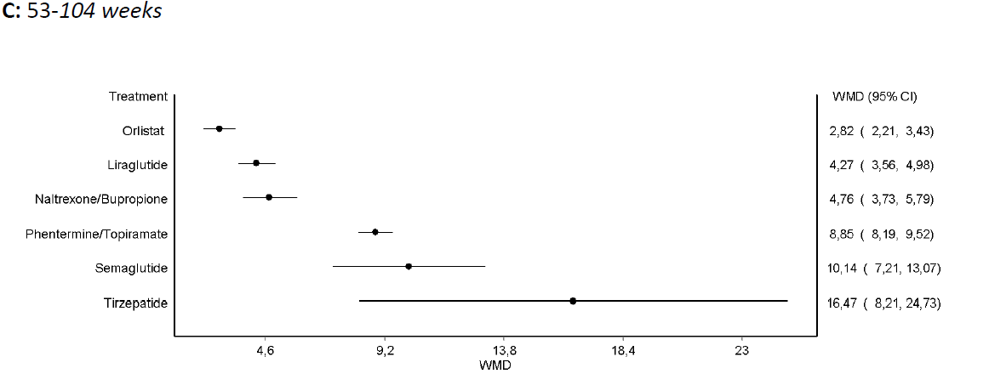
Total Body Weight Loss, %

Slide 7
De Luca et al., manuscript submitted
Notes:
Paradoxically and quite surprisingly, SICOB and IFSO, two surgeons' associations, were more enlightened in trying to compare different anti-obesity strategies (both surgical and nonsurgical).

Slide 8
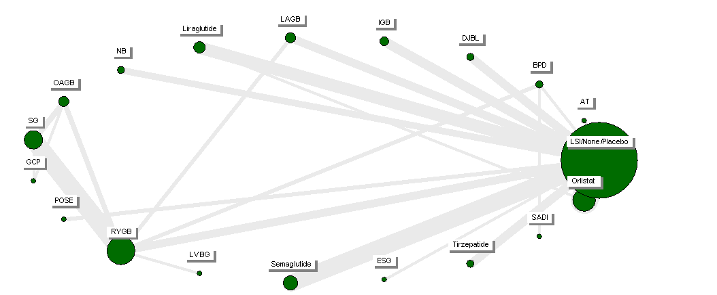
From 26 weeks to 10 years
N= 150 comparisons

Slide 9
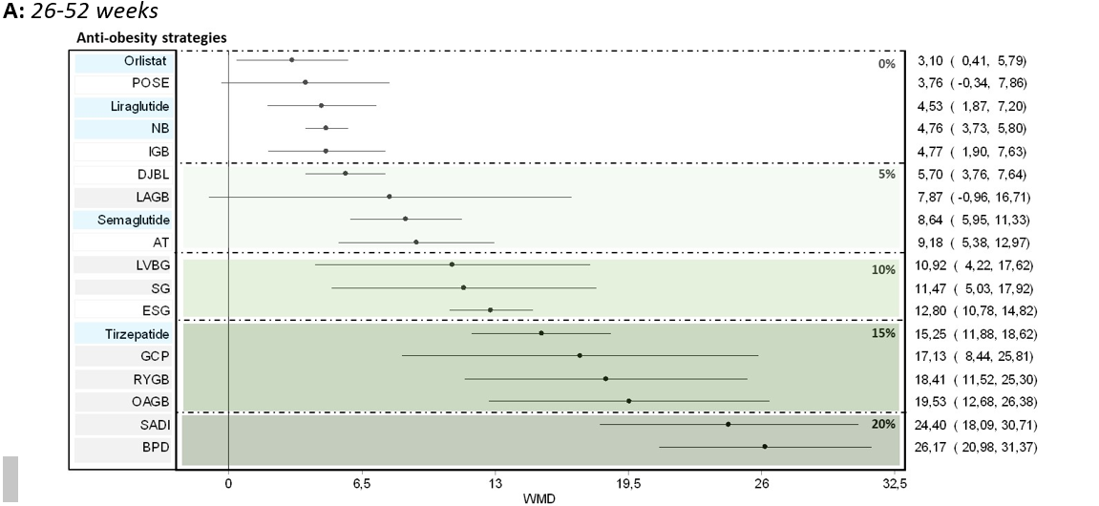
Total Body Weight Loss, %

Slide 10
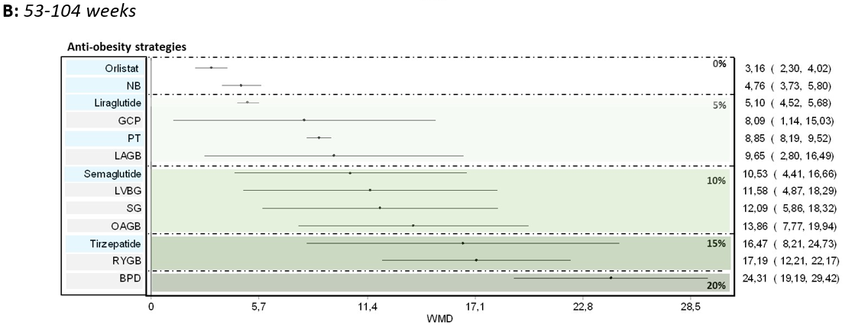
Total Body Weight Loss, %

Slide 11
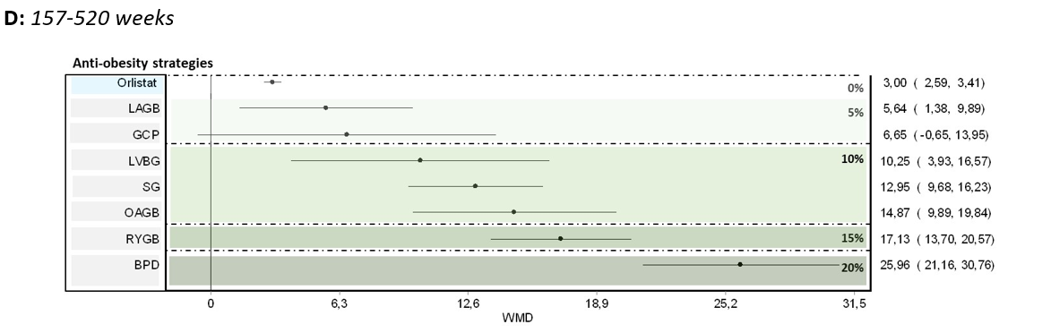
Total Body Weight Loss, %

Slide 12
Barazzoni et al., Eating and Weight Disorders, 2025. In press
Notes:
SIO was impressed by the methanlitical analyses performed for SICOB and IFSO and they asked me to replicate these analyses (excluding strategies not approved by EMA) divided into three different BMI categories

Slide 13
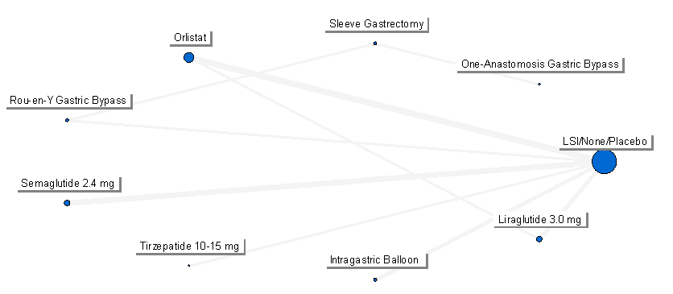
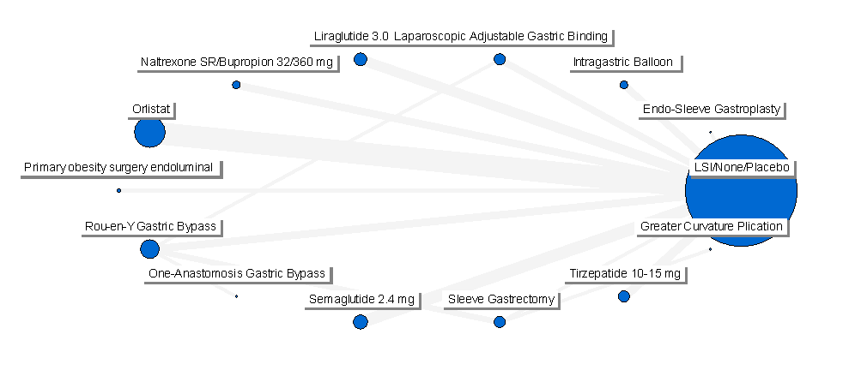
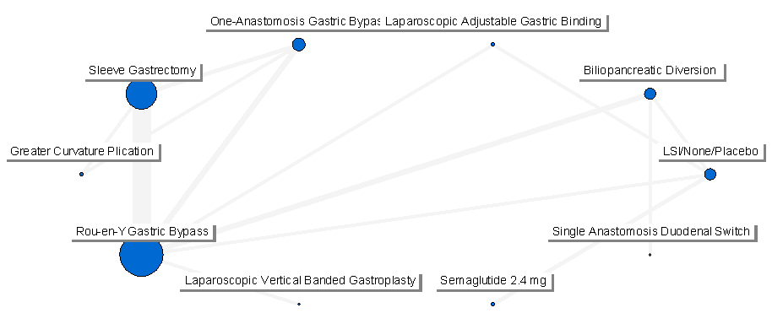
Mean BMI at entry 30-34.9 kg/m²
N= 23 comparisons
Mean BMI at entry 35-39.9 kg/m²
N= 62 comparisons
Mean BMI at entry> 39.9 kg/m²
N= 51 comparisons
Notes:
SIO was impressed by the methanlitical plan/analyses performed by SICOB and IFSO and they asked me to replicate these analyses (excluding strategies not approved by EMA) divided fro three different BMI categories

Slide 14
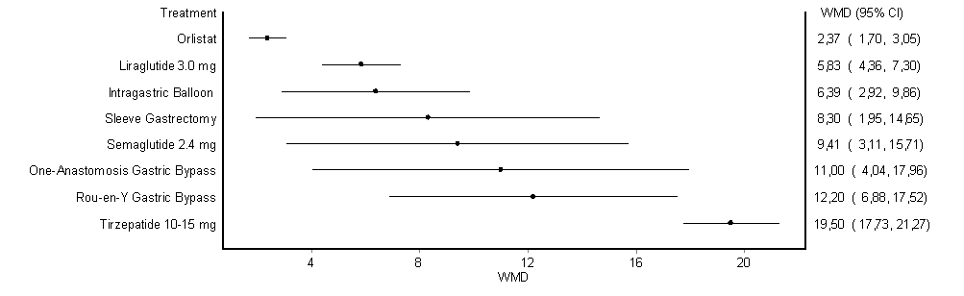
Mean BMI at entry 30-34.9 kg/m²
N= 23 comparisons
Total Body Weight Loss, %
Notes:
SIO was impressed by the methanlitical plan/analyses performed by SICOB and IFSO and they asked me to replicate these analyses (excluding strategies not approved by EMA) divided fro three different BMI categories

Slide 15
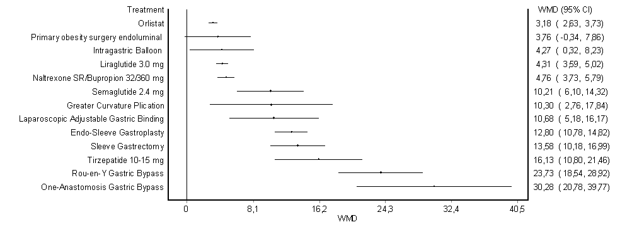
Mean BMI at entry 35-39.9 kg/m²
N= 62 comparisons
Total Body Weight Loss, %
Notes:
SIO was impressed by the methanlitical plan/analyses performed by SICOB and IFSO and they asked me to replicate these analyses (excluding strategies not approved by EMA) divided fro three different BMI categories

Slide 16
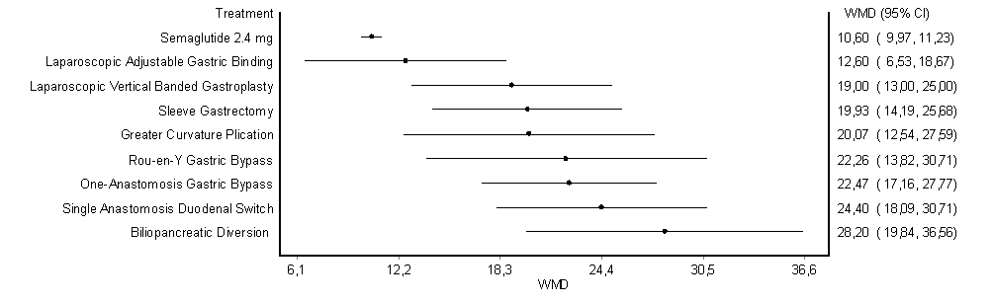
Mean BMI at entry >39.9 kg/m²
N= 51 comparisons
Total Body Weight Loss, %
Notes:
SIO was impressed by the methanlitical plan/analyses performed by SICOB and IFSO and they asked me to replicate these analyses (excluding strategies not approved by EMA) divided fro three different BMI categories

Slide 17
TAKE-HOME MESSAGES
Patients to be prioritized for OMM cannot be selected just based on their initial BMI, but also for other parameters:
Therapeutic goals (amount of BW reduction required, complications management, etc.)
Other baseline clinical characteristics (e.g., presence of obesity-associated medical conditions, obesity-related complications)
Operative risks
OMM contraindications
Patients’ preference, etc.
We need to build evidence taking into account all (and others) these parameters to tailor anti-obesity strategies
We should stop to consider LSI, OMM, and MBS as alternative therapies…. (MULTIMODAL APPROACH!)

Slide 18
Grazie

